Slide 1
Wine Quality Machine Learning
UT Data Analytics Bootcamp 2020 Group 5
Notes:
Intro Slide

Slide 2

Why did we choose wine ???
Notes:
Because everyone likes wine
Lots of historical data to pull wine qualities by appellation for red and white wine
Weather and soil data also available by appellation to be able to tie all three together for model predictions

Slide 3

Questions ???
How does weather impact wine quality?
How does score vary by region in USA , by type ( red, white) ?
How does soil quality affect wine quality ?

Slide 5
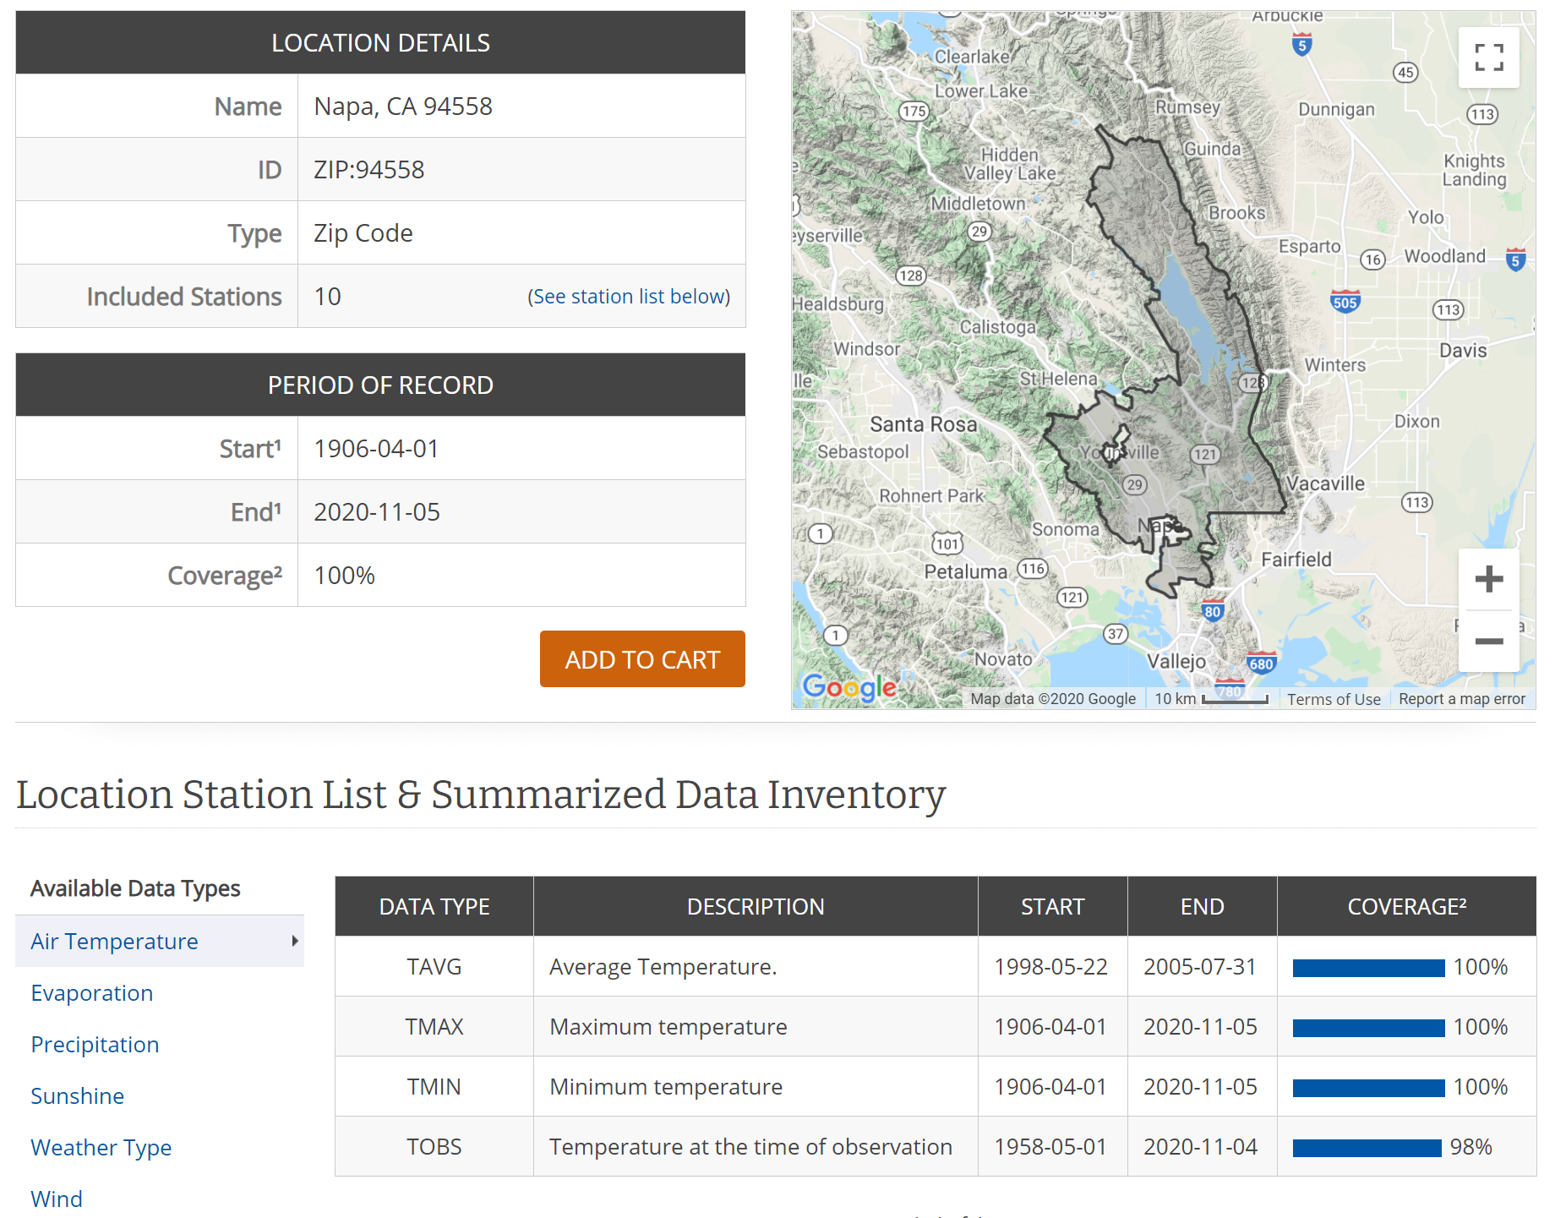
Data Exploration
Notes:
shows the requirements we need to pull data including the start date, temperature and precipitation, and the percent covered by the tools.

Slide 6
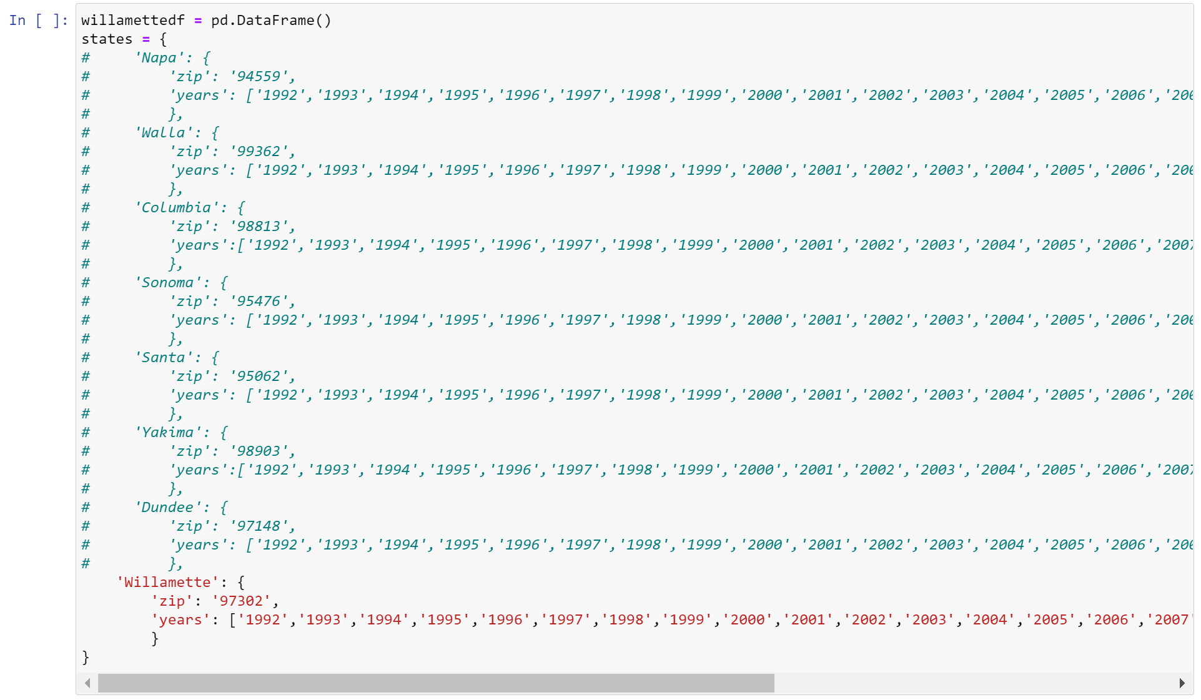
Data Exploration - Continued
Notes:
shows how we iterated over multiple zip codes for temp and precipitation

Slide 7
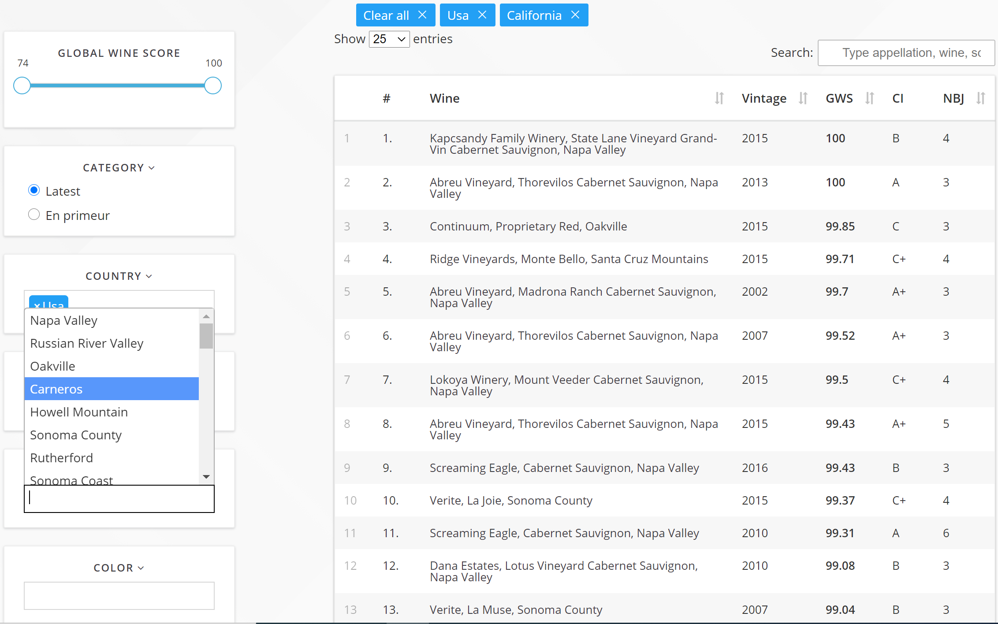
Data Exploration - Continued
Notes:
This is the Global Wine API and shows some of the inputs that are required for the API

Slide 8
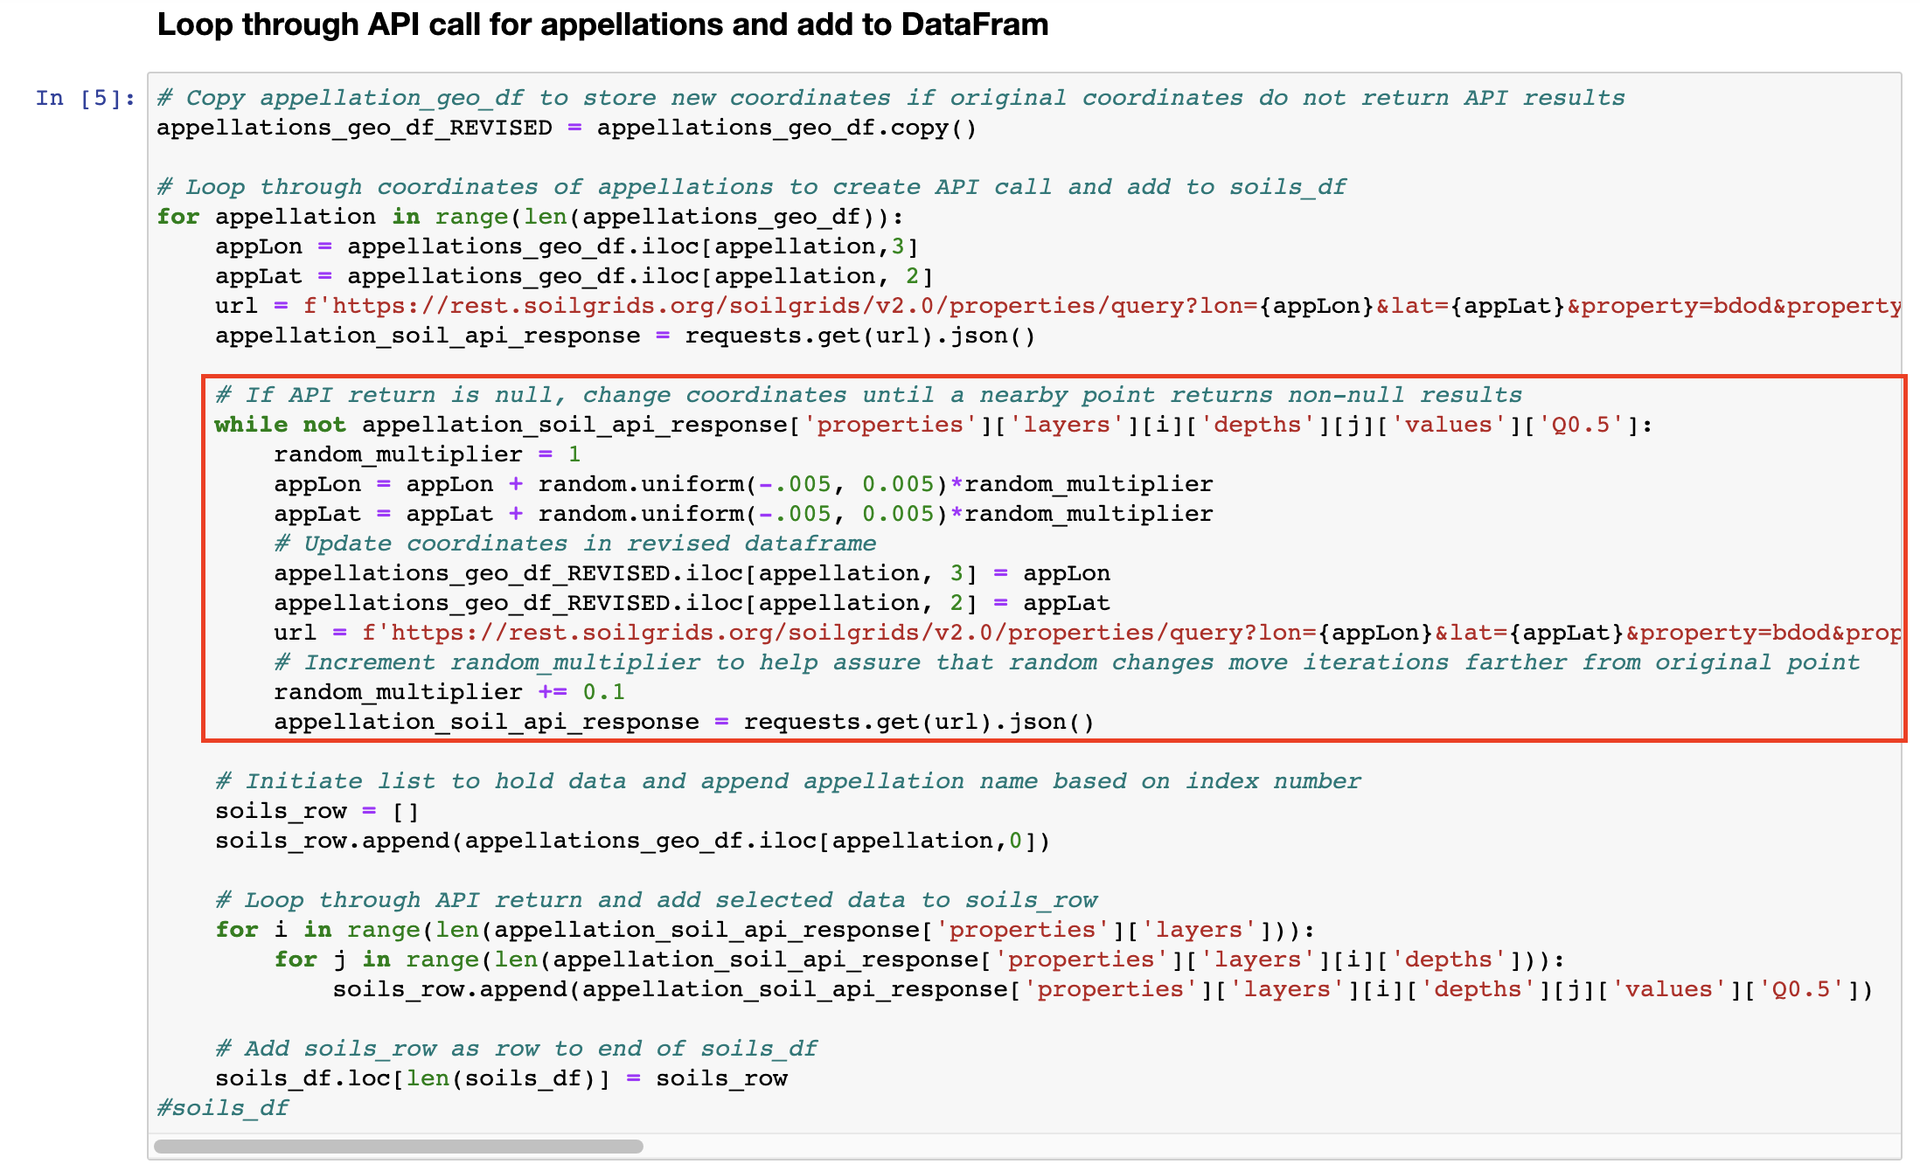
Data Exploration - Continued
Notes:
Input for soil api required lat/lon pair but not ever lat/lon was viable. This bit of code would enable if the result was null. It would move the lat/lon by a random amount of up to approx 1800 feet in either direct on both lat and lon and try grabbing a non-null value. If the resultant value was null, it would repeat, but add 10% to the random distance each iteration.

Slide 9
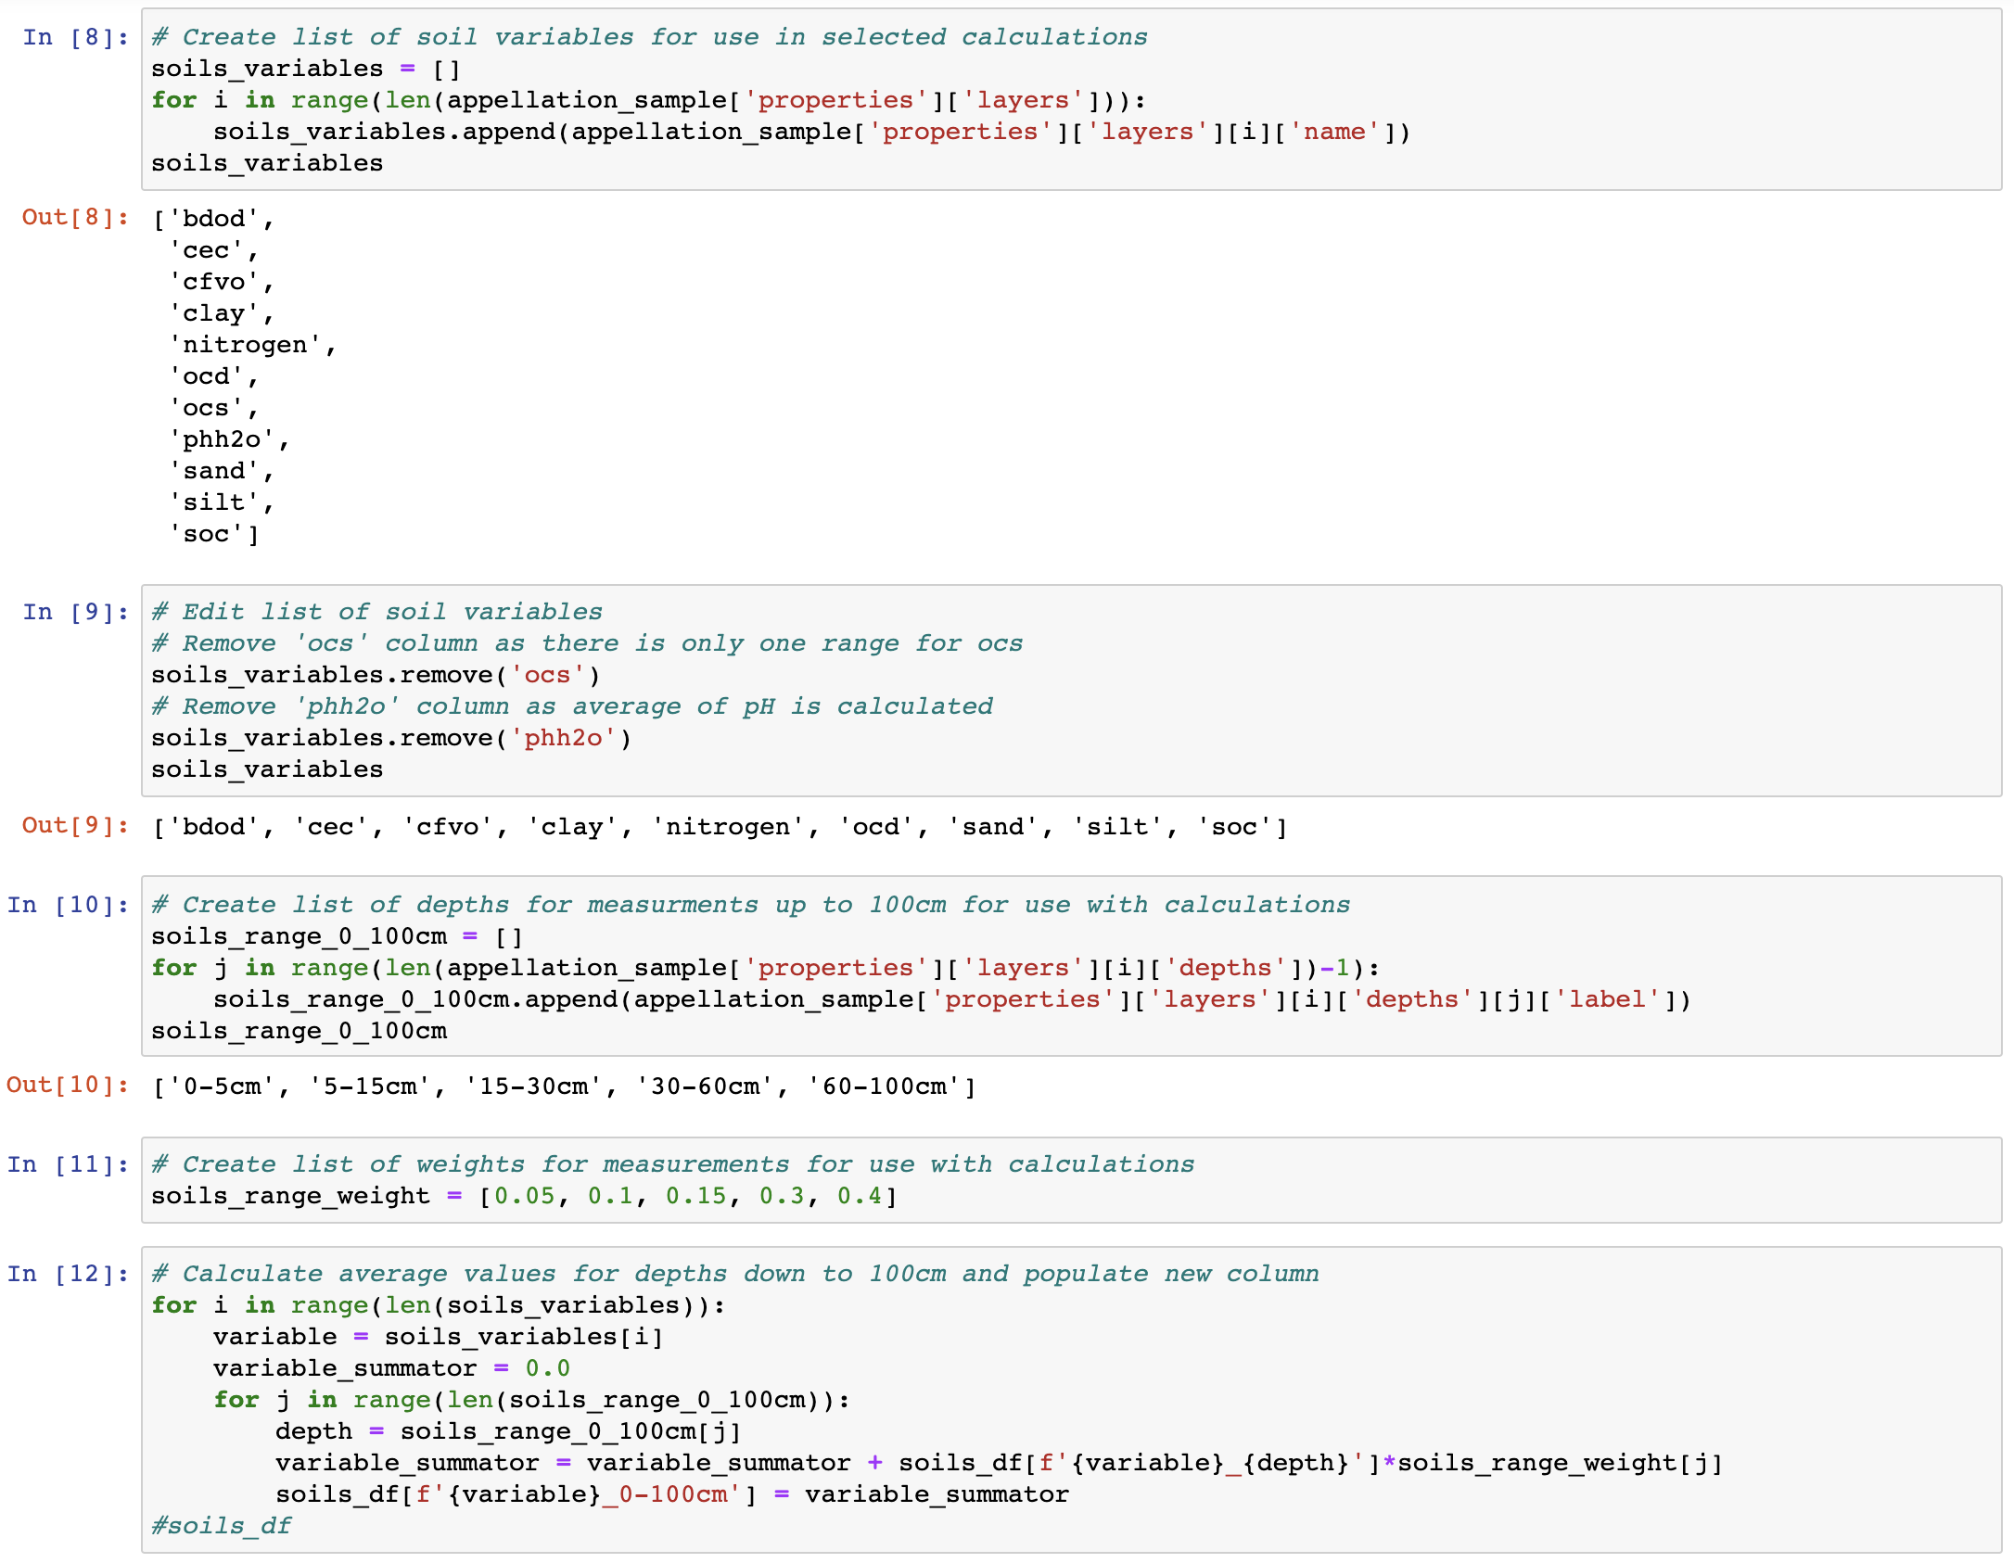
Data Exploration - Continued
Notes:
This code here is one example of the loop used to summarize data from 0-100cm. This reduced the data points from 61 per location to 25 by reducing 5 of the measurements to 1 on 9 of the variables. Another similar operation reduced the variables to 21 by reducing a 10th variable. The 11th variable only had 1 measurement.

Slide 10
Database
We utilized Amazon AWS and PgAdmin for SQL database
Created 4 tables in the database
Joined red wine and white wine dataframes with the soil dataframe

Slide 11
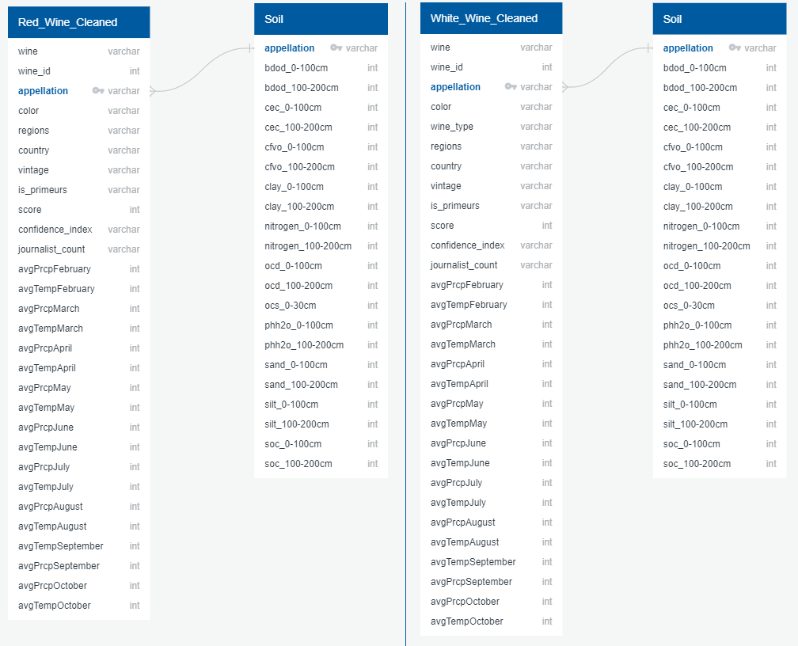
Database - continued
Notes:
ERD for database

Slide 12
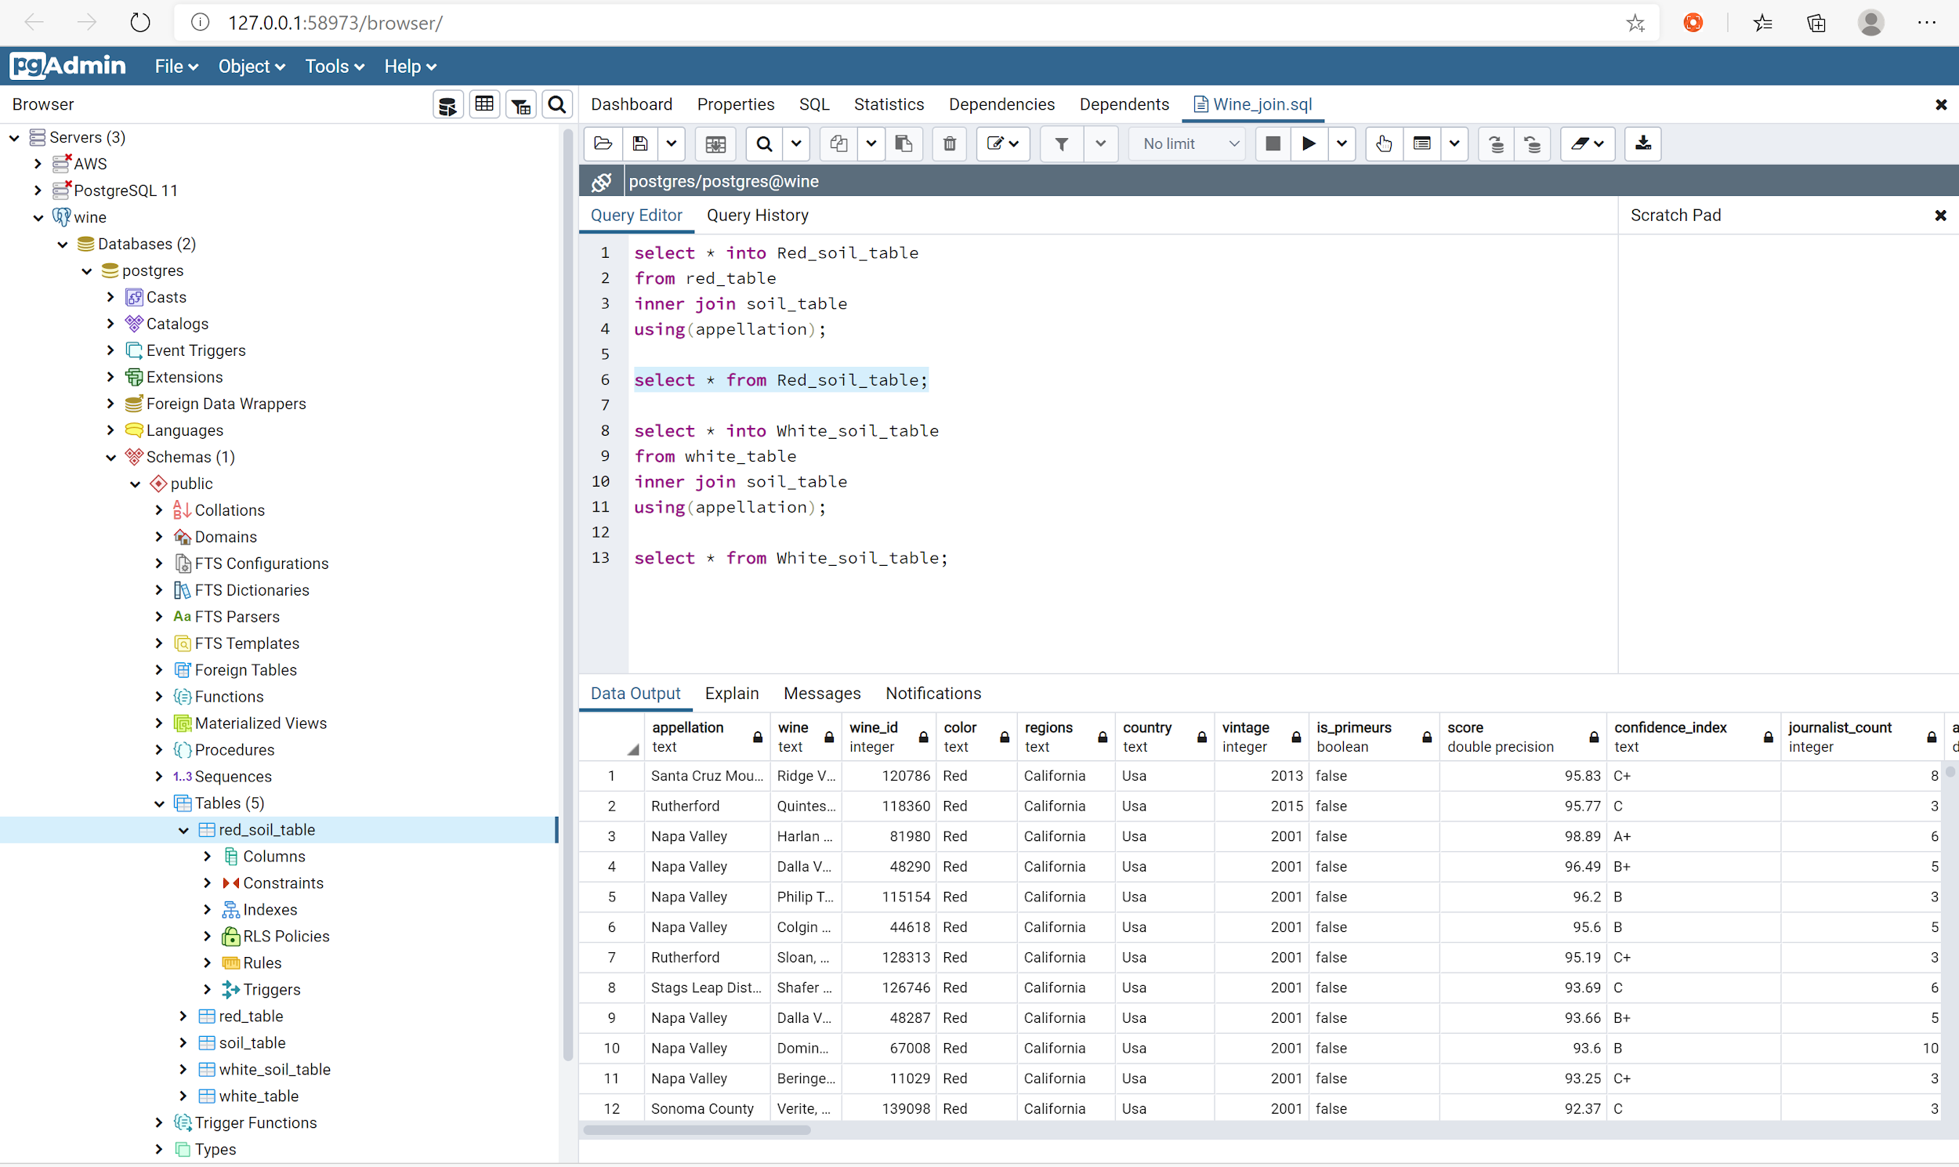
Database - continued
Notes:
Red wine dataframe joined with soil data

Slide 13
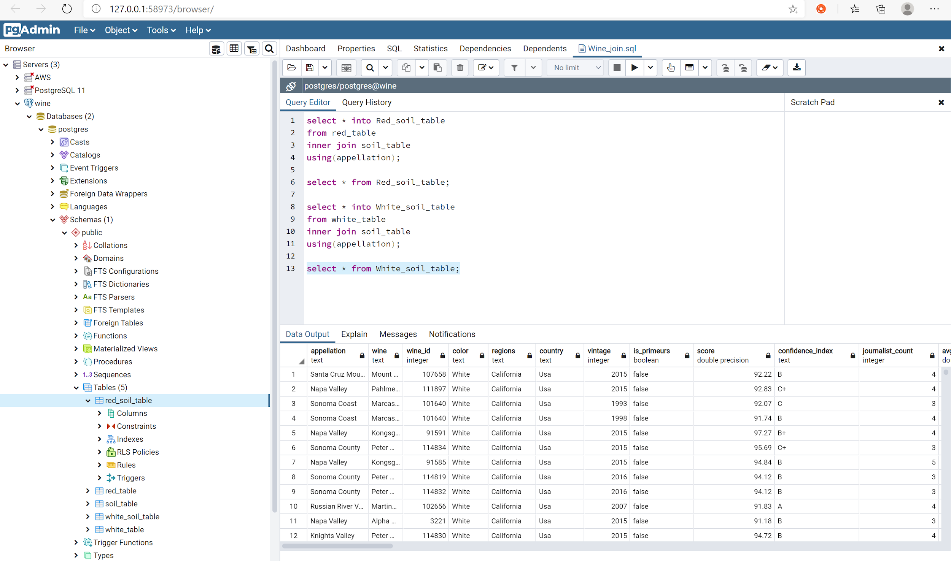
Database - continued

Slide 14
Machine Learning - Data Preprocessing
Checked for null values
Checked the data types
Converted the score column from float to integer and split score into good(1) which is any wine with a score >= 91 and bad(0) and making it its own column "quality" to use as our target.
Checked for number of unique values in each column to find out which columns required binning and binned appellation.
Created the OneHotEncoder instance, Fitted the encoder and produce encoded DataFrame and renamed encoded columns.
Merged one-hot encoded features and drop the originals

Slide 15
Machine Learning - Prelim Feature Engineering and Selection
Utilized the wine score to determine the quality of wine and for feature we decided to look at wine data by itself and dropping all weather and soil data columns and unnecessary columns from the wine data, wine data with weather data, wine data with soil data and wine data with weather and soil data.

Slide 16
Machine Learning - Training and Test Data
Used sklearn train_test_split to split the dataset into random train and test subsets.

Slide 17
Machine Learning - Model types
Deep Learning Neural Network - The limitation of the model is that it requires a large amount of data and it's not easy to comprehend. The benefits of this model can solve complex problems.
Random Forest Classifier - The limitation is that features need to have some predictive power to work. The benefit is handling of huge amount of data, No problem of overfitting
Logistic Regression - The limitation of the model is that it can be easily outperformed by sturdier model like Neural Networks, also its high reliance on a proper presentation of your data. The benefits of this model are that it's easier to implement, very efficient to train and it outputs well-calibrated predicted probabilities.

Slide 18
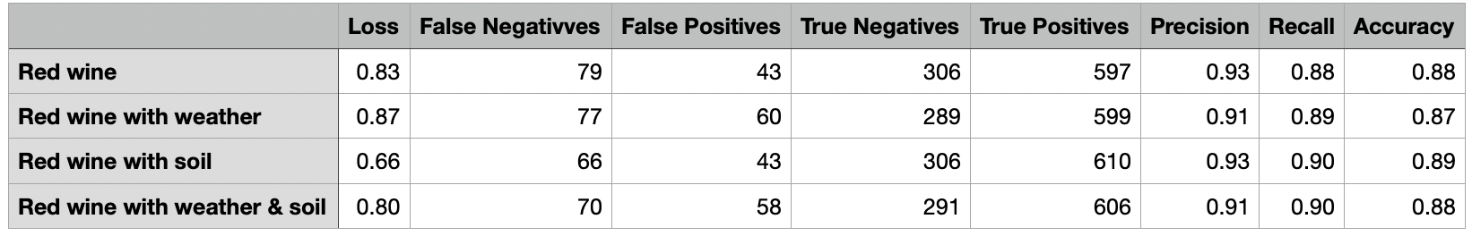

Machine Learning - Deep Learning Neural Network

Slide 19
Machine Learning - Random Forest Classifier

Slide 20
Machine Learning - Logistic Regression

Slide 21
Analysis
Logistic Regression model as the best fit model for this analysis after trying multiple models and considering the structure of our data to help answer our questions. Will add more here

Slide 22
Description of the source of data
Wine API - https://www.globalwinescore.com/api/
Weather API - https://www.ncei.noaa.gov/access/search/data-search/global-summary-of-the-year
Weather Analysis - https://www.evineyardapp.com/blog/2019/01/17/climate-weather-and-vineyard-management/
All data source will be adding to this slide.

Slide 23


